Slide 1
A Recommender System for Restaurant Finder
Applied Data Science Capstone
Report on
Pradip Mane

Slide 2
Introduction
The key objective of a Restaurant Finder is to provide users with a curated list of all the restaurants based on their location or search criterion. In spite of making a time taking research on the Internet, one can simply look up for and locate best restaurants as per their location, taste, and preferred cuisine.
Users can simply browse through restaurants’ menus, pictures, ratings and reviews; and decide where they want to eat. Restaurant Finder Apps can also be used to look for meal take away and delivery services, cafes, night clubs, grocery stores, super markets, etc.

Slide 3
Problem Description
This Restaurant Finder provides places such as: Different types of Restaurants, Bakery, Breakfast Spot, Brewery and Café with fresh and high-quality groceries. Restaurant Finder make a great way to look up and discover great places to eat at or order in from, letting a user explore all the dining options in one of the boroughs of Toronto (Scarborough).

Slide 4
Data Gathering
We will need geo-locational information about that specific borough and the neighborhoods in that borough. We assume it is "Scarborough" in Toronto. This is easily provided for us by the contractor, because the contractor has already made up his mind about the borough.
We will need data about different venues in different neighborhoods of that specific borough. In order to gain that information we will use "Foursquare" locational information. By locational information for each venue we mean basic and advanced information about that venue.

Slide 5
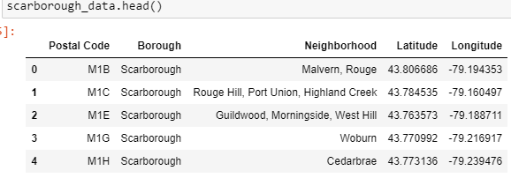
Methodology
Identifying Postal Codes (and then Neighborhoods) in "Scarborough"

Slide 6
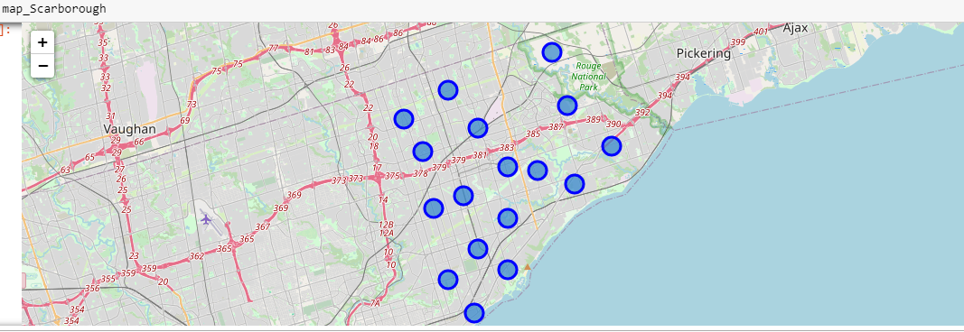
Methodology
Identifying Postal Codes (and then Neighborhoods) in "Scarborough"

Slide 7
Methodology
Using Foursquare and Retrieving Locational Data for Each Venue in Every Neighborhood
After finding the list of neighborhoods, we then connect to the Foursquare API to gather information about venues inside each and every neighborhood.

Slide 8
Methodology
3. Processing the Retrieved Data and Creating a DataFrame for All the Venues inside the Scarborough
When the data is completely gathered, we will perform processing on that raw data to find our desirable features for each venue.

Slide 9
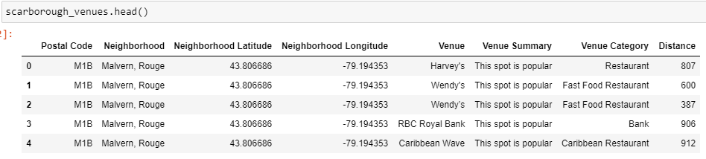
Methodology
Processing the Retrieved Data and Creating a DataFrome for All the Venues inside the Scarborough

Slide 10
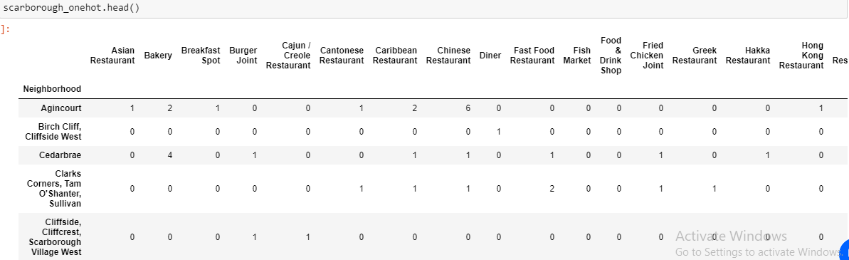
Methodology
4. One-hot "categroies" Column into Unique Categorical Feature.

Slide 11
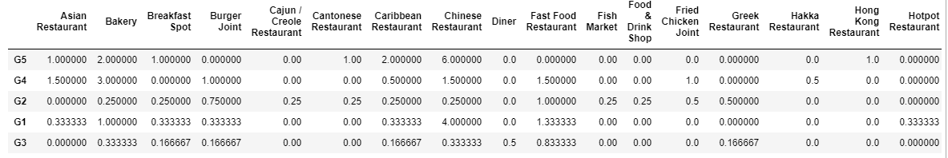
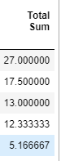
Methodology
5. using k-means to Cluster Neighborhoods into 5 Clusters

Slide 12
Decision Making
Now, we focus on the centers of clusters and compare them for their "Total Restaurants" and their "Total Joints". The group which its center has the highest "Total Sum" will be our best recommendation to the contractor. {Note: Total Sum = Total Restaurants + Total Joints.}

Slide 13
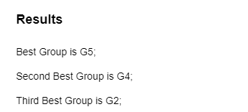
Results

Slide 14
THANK YOU

